Slide 1
Best Practices
Ashored Mini Investment Memo

Slide 2
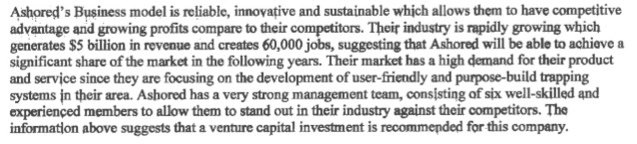
Company

Slide 3
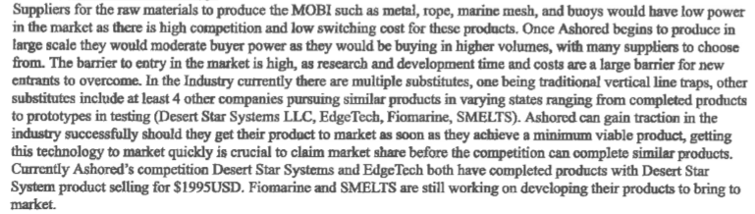
Industry – Competitors and Suppliers

Slide 4
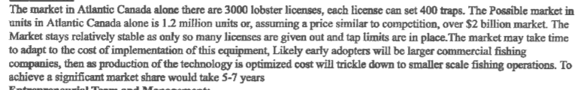
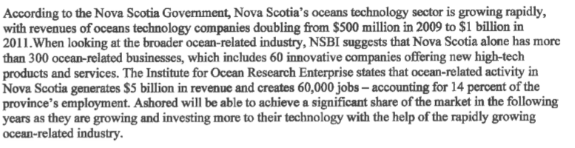
Market - Customers

Slide 5
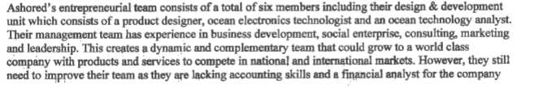
Entrepreneurial Team – Management Team – Co-founders

Slide 6
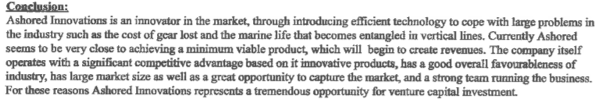
Conclusion

Slide 7
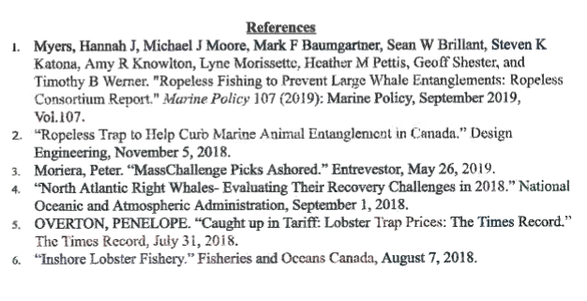
References

